Slide 1



EDSA Linear
Regression Predict
Spain Electricity Shortfall Challenge
Giving back to the community.

Slide 2


About Us
We are Team III
(aka - The EDSA Data Wranglers)
Team Members:
Collen Bothma
Rizqah Meniers
Bornwise Mahlaule
Floyd Skakane
Gabriel Maja

Slide 3




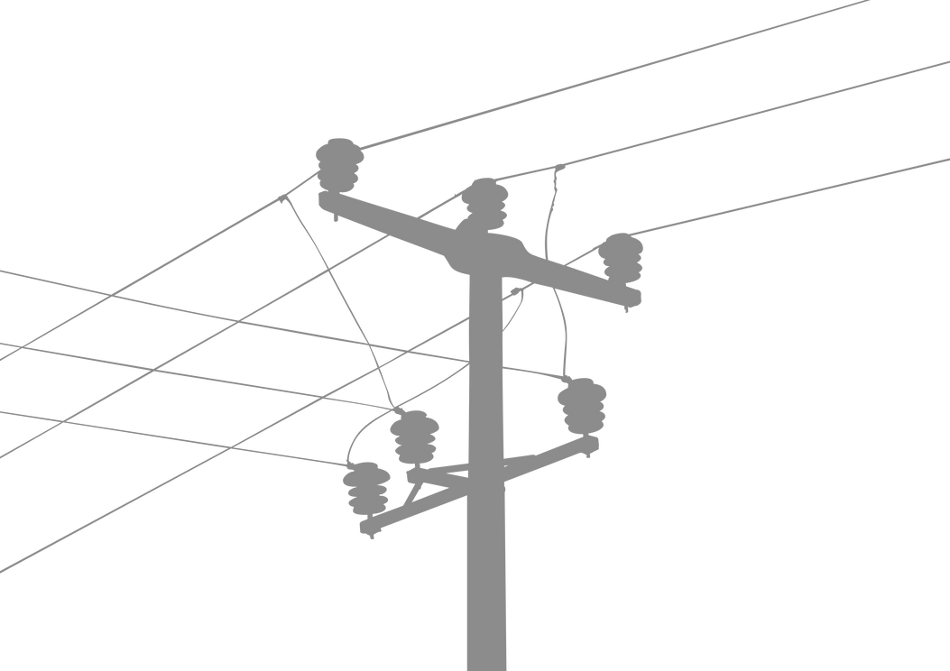
The Problem
Spain
The supply of electricity plays a huge role in the livelihood of citizens in a country.
There is therefore a need to 'keep the lights on' in order to maintain and improve the economy of a country by investing in electricity infrastructure.
However in recent years, evidence suggests that using purely non-renewable energy sources is not sustainable.
The Spanish government is looking into expanding its renewable energy resource infrastructure investments.
As such - they require info on the trends and patterns of their renewable sources (they have been tracking the various energy sources in the country)
EDSA Data Wranglers to the Rescue!!!

Slide 4




Solution Process
The Data
Gathering
Data
TARGET
VARIABLE
FEATURE VARIABLES
The unprocessed data for this particular project was already provided.
(i.e - no gathering of data was necessary)
Load Shortfall (3h)
Temperature
Weather ID
Wind Degree
Rain
Pressure
Humidity
Snow
DateTime
Max Temperature
Wind Speed
Min Temperature

Slide 5



Solution Process
Feature Engineering
A total of 47 features were present in the data.
Data was relatively clean.
Only the Valencia_Pressure Feature contained missing values.
Used the mode to fill missing values.
A total of 3 features were non-numerical.
These 3 features were converted to numerical form.
New features were engineered from the DateTime variable.
These new features were used to improve model performance.

Slide 6


Solution Process
Data Anomalies
The temperature-related variables were highly correlated with each other despite being captured from various cities.
A few features presented extreme values in terms of skewness.
A few features had extreme kurtosis values - signifying the presence of outliers in the data.
Some missing values which were quickly and effectively dealt with.

Slide 7




Analytical Approach
We made use of Supervised Learning to tackle this Project.
A comparison was made between 3 different models:
Linear Regression Model
Random Forest Model
LASSO Model

Slide 8
Model Training
DateTime feature dropped
DateTime feature included and split into components
Clean
Dataset
Clean
Dataset
Features standardised
Features kept the same
Features standardised
Features kept the same
Standardised
Dataset
Clean
Dataset
Standardised
Dataset
Clean
Dataset
Train/Test Split
Train/Test
Split
Train/Test Split
Train/Test
Split
Linear
Regression
Training
Random Forest Model
Training
LASSO Model Training
Linear
Regression
Training
Random Forest Model
Training
LASSO Model Training

Slide 9
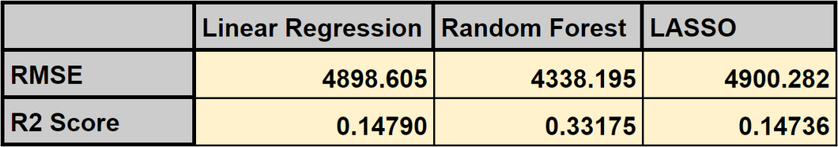
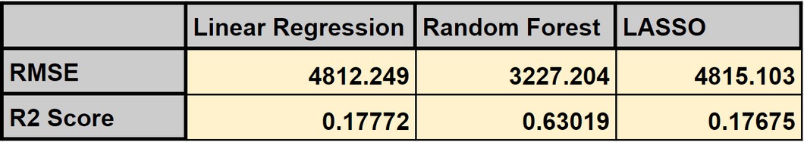
Model Performance
DateTime feature included and split into components
DateTime feature dropped
Model Selection
Our Chosen Model:
The Random Forest Model
Presented the lowest RMSE score: 3227
Presented the highest R2 Model Accuracy:
63% Accuracy
(with inclusion of DateTime fearures)

Slide 10
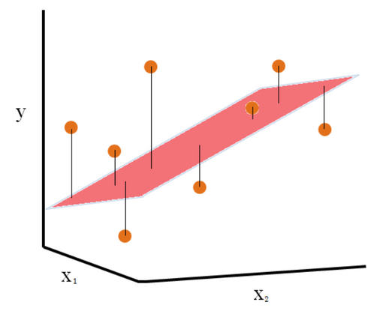

Model Summary
Our Chosen Model:
RMSE score of 3227.
Data points more closely fitted to our regression plane.
Our Chosen Model:
R2 score of 63%.
Good relationship between our model and the dependent variable.
(i.e - load shortfall)
(In comparison to
other models)
Also Noticeable:
A clear improvement in model accuracy when we include the DateTime features.
MODEL VALUE
We are now able to predict the unknown load shortfall values to an accuracy of 63%

Slide 11
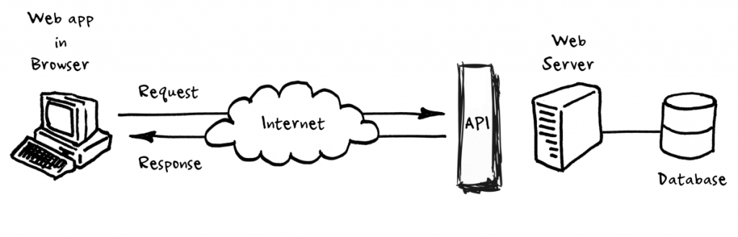

API
Deployment

Slide 12
Thank You!
Thank You!
mission success!
EDSA Data Wranglers is the name,
building super models is the game!!

